Slide 1
Microsoft Power BI
Lessons from the Enterprise:
Managed self-service BI at global scale
Matthew Roche
@SQLAllFather
https://ssbipolar.com
Notes:
“Starter” slides taken from the Power BI Adoption Framework: https://info.microsoft.com/ww-landing-powerbi-adoption-framework-series.html

Slide 2

Introductions
Matthew Roche
Power BI CAT team
Enterprise BI body of knowledge

Slide 3
Agenda
Self-service BI as a two-edged sword
Reviewing key topics
Three patterns of enterprise adoption

Slide 4









Learning from existing customers
Addressing Technical Issues
Clear BI Strategy
Plan
Exec Sponsor
User Community Profile
Data Quality
Compliance, Security, Governance
Infrastructure
Adoption Plan
Clear BI scenarios
Centre of Excellence
Product Gaps

Slide 5

Self-service BI tools are sometimes described as a two-edged sword
Notes:
Image from https://www.albion-swords.com/NEXTGEN%20HAND%20AND%20A%20HALF%20SWORDS.html
https://www.albion-swords.com/images/Albion%20Swords%20Listings/Talhoffer.jpg
Buy one of these.
If you don’t want one, buy ME one of these.

Slide 6

Self-Service BI as a Two-Edged Sword
Why does this mean “something that has or can have both favorable and unfavorable consequences”?
It should instead mean “something that can be used in multiple ways, with each way having specific strengths and weaknesses.”
When you know how to use the true edge and the false edge, you have significant advantages over an opponent with a single-edge sword. Rather than fearing your weapon, you should learn its capabilities for optimal use.
Notes:
Definition from https://www.merriam-webster.com/dictionary/double-edged%20sword
Image from https://www.albion-swords.com/images/Albion%20Swords%20Listings/Talhoffer.jpg

Slide 7
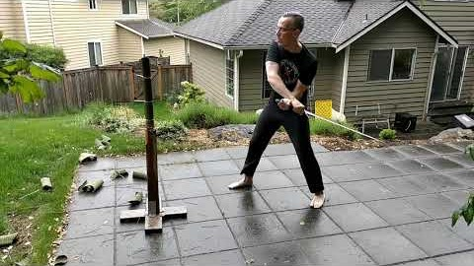
True Edge, False Edge - IT and SSBI
True Edge Rising
Notes:
https://www.youtube.com/watch?v=DsWyGKgLPiI

Slide 8
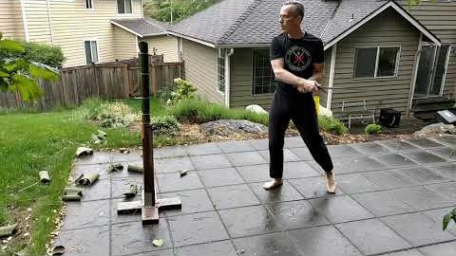
True Edge, False Edge - IT and SSBI
False Edge Rising
Notes:
https://www.youtube.com/watch?v=whMaMc-xq-g

Slide 9
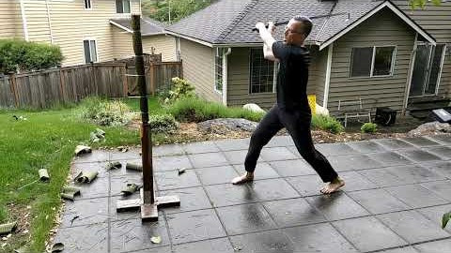
True Edge, False Edge - IT and SSBI
False Edge / True Edge Combo
Notes:
https://www.youtube.com/watch?v=EmZORTeNN4s

Slide 10
Self-Service BI as a Two-Edged Sword
True edge: Strength, power, mechanical advantage. Use when possible. Plan to use the true edge.
False edge: Weaker, more limited use cases, no mechanical advantage. Agile and quick. Use the false opportunistically, as necessary and appropriate.
False edge and true edge in combination: Greater than the sum of its parts
Both: Requires training and practice, and an understanding of each technique.
Notes:
Image from https://www.albion-swords.com/images/Albion%20Swords%20Listings/Talhoffer.jpg

Slide 11
What organizational goals do you want to achieve with the roll out of Power BI?
Does BI start top down or bottom up?
Where does change start? Technology or people?
Who should be allowed to see and use business intelligence data?
Fail quickly? What do you mean by that and how does it apply to business intelligence?

Slide 12
What do actual swords and edges have to do with Power BI? Does this analogy hold up?
In most large organizations, BI starts from the top AND the bottom
Change starts where the pain is felt the most, which could be in business or in IT… but is usually more on the business side
Business users need access to the BI data and tools that they need to complete their tasks, and they will get it with or without IT support
Successful enterprises embrace top-down and bottom-up patterns of adoption
The key to success is finding the right balance for the organization, and when to use each approach

Slide 13
Two sharp edges are dangerous only if you don’t know they’re both sharp
Notes:
Image from https://www.albion-swords.com/images/Albion%20Swords%20Listings/Talhoffer.jpg

Slide 14
Why Governance is Needed
Plan ahead for self-service BI success
Avoid uncontrolled proliferation of BI apps
Implement processes
Proper governance processes
Drive Decisions
Reduce Risks
Increase user adoption

Slide 15
Why Governance is Needed
Plan ahead for self-service BI success
Guide the SSBI efforts you cannot stop
Empower the SSBI users with tools and help
Proper governance processes
Define responsibilities
Encouraged desired behaviors
Discourage undesired behaviors

Slide 16
Governance Model
TIGHT CONTROLS
EDW
Permanent record
Subject to compliance
Push down content
Reporting services
BUSINESS UNIT
DASHBOARDS, KPIS & SCORECARDS
Push up content
Power BI Desktop
Excel or other reports
Knowledge management
Information sharing
DEPARTMENTAL, TEAM OR GROUP REPORTING
PROJECT REPORTING
Personal/Private views
Data science exploration
PERSONAL REPORTING
LESS CONTROLS

Slide 17
Governance Model – Who Does What?
TIGHT CONTROLS
EDW
Permanent record
Subject to compliance
Push down content
Reporting services
BUSINESS UNIT
DASHBOARDS, KPIS & SCORECARDS
IT-developed and maintained
Consistent criteria and responsibilities
Business developed and maintained
Push up content
Power BI Desktop
Excel or other reports
Knowledge management
Information sharing
DEPARTMENTAL, TEAM OR GROUP REPORTING
PROJECT REPORTING
Personal/Private views
Data science exploration
PERSONAL REPORTING
LESS CONTROLS

Slide 18
Power BI deployment modes
Power BI delivery: three approaches

Slide 19
Power BI deployment modes
Power BI delivery: three approaches

Slide 20
Are you looking to build a Center of Excellence Team?
Actions
Use Teams / Yammer / SharePoint / Email
Help support self-service reporting solutions
Answer questions
Run lunch and learns
Governance videos / documentation
Solution examples / videos
FAQs
Useful links to external support or training material

Slide 21
Are you looking to build a Center of Excellence Team? Start with the business!
Actions
Use Teams / Yammer / SharePoint – provide both a community and a knowledge base
Help support self-service reporting solutions – empower users to build what you want them to build
Answer questions – AND recognize and encourage community members who do so as well
Run lunch and learns – make the training available when and where users need it
Governance videos / documentation – show how to use your data, not just the technology
Solution examples / videos – demonstrate the art of the possible
FAQs – include content for tools, technology, data sources, processes, and more
Useful links to external support or training material – incorporate this in your training content

Slide 22
Three emerging patterns from CAT team engagements - #1: Wild West
Power BI Pro licenses are made available to most or all business users
Office 365 enterprise licenses
Other bulk purchases
IT supports and maintains central data sources, and supports Power BI service and tools
Additional Premium capacity added to support increased unmanaged application load
Business users build and deploy solutions to meet their own requirements
Results
Duplicate, overlapping solutions
Inconsistent numbers and values
Reduced trust and satisfaction

Slide 23
Three emerging patterns from CAT team engagements - #2: Lockdown
A central team in IT does all Power BI development
Business has processes for submitting requirements
IT has processes for prioritizing requests and delivering solutions
IT supports and maintains Power BI service and solutions
Results
Gaps in required BI solutions
Shadow data
Multiple BI tools
Reduced trust and satisfaction

Slide 24
Three emerging patterns from CAT team engagements - #3: Harmonious Balance
Licenses and training are made available to appropriate business users
Users receive the resources and knowledge they need to be successful
Users are given clear guardrails to guide their successful adoption
Pro license availability and access to Premium capacity often used as enforcement mechanisms
IT supports and maintains central data, services and tools, and key BI solutions
IT makes “single sources of truth” available to authorized business users – increasingly involving dataflows
IT provides guidelines for business developing solutions to meet their own requirements
Business users build and deploy solutions - hand off to IT as appropriate, following processes
Results
Small IT teams can successfully support very large user bases
Lower costs, more predictability, and an increasing momentum of growth and usage
Increased trust and satisfaction

Slide 25
Three emerging patterns from CAT team engagements - #4: No size fits all
There are many variations on these themes, but key factors include
Clearly defined roles, responsibilities, and processes
The right training resources for every persona – don’t forget content consumers!
Shared resources and an open culture of data
Business is empowered to meet its own needs
IT is empowered to oversee, secure, and control
A successful center of excellence involves engagement from both business and IT
Without appropriate executive sponsorship, success is almost impossible

Slide 26
The most important long-term success factors
Training – you can’t use the tool you don’t know
Business leadership – make business the face of business intelligence
Culture – promote, recognize, and reward proper behaviors
Flexibility and growth – no plan survives contact with the enemy, so plan proactively to be adaptable
Executive sponsorship and support – success only lasts as long as executive leaders support your efforts

Slide 27

Notes:
https://www.londonlongsword.com/

Slide 28
Questions
Answers

